Slide 1
ARTIFICIAL INTELLIGENT MONITORING SYSTEM(AIMS)
CH.SAI AKHIL
192311311

Slide 2
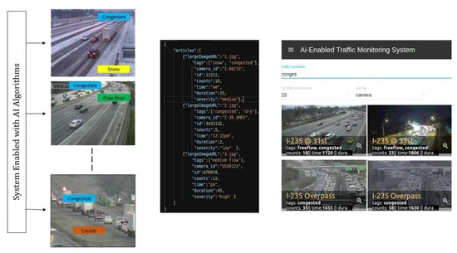
INTRODUCTION:
Monitoring traffic effectively has been one of the most important efforts in transportation engineering for years. To this day, most of the traffic monitoring centers rely on human operators to track the nature of traffic flows and oversee any incidents happening on the roads.
An AI-enabled system can recognize every vehicle and, further, track characteristic movement patterns of the vehicle in order to identify dangerous driving behavior, such as erratic lane changing behavior. Another important aspect of an AI-enabled traffic monitoring system is the correct detection of any stationary vehicles on the road.
Figure 1. Proposed front-end GUI-based system with algorithms and traffic database processed in the back end. To visualize the demonstration of the proposed GUI based platform, refer toMonitoring traffic congestion
Traffic accidents, stationary or stranded vehicle detection
Vehicle detection and count
Managing traffic using a stand-alone Graphical User Interface (GUI)
Scaling traffic monitoring to multiple traffic cameras
FIGURE 1

Slide 3
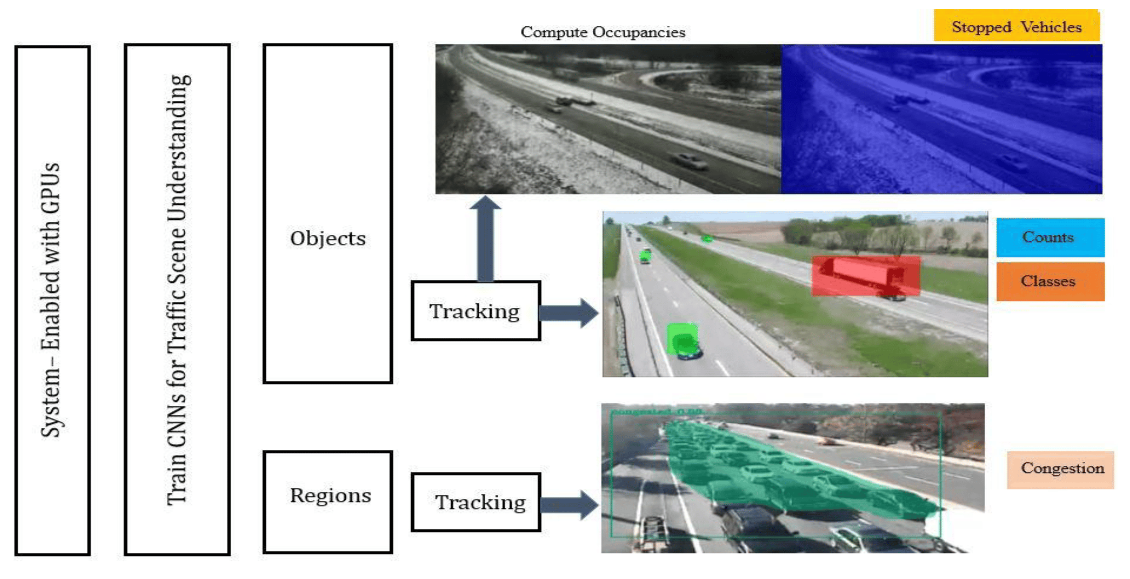
PROPOSED METHOLOGY:
The methodology adopted in implementing an automatic traffic monitoring system is illustrated in Figure 2. The main components consist of, first, a GPU-enabled backend that needs to be on-premise and designed in such a manner that very deep models can be trained quickly and run on a wide array of cameras in near real-time. At the very core of the proposed AI-enabled traffic monitoring system lies the development and training of a number of deep convolutional neural network models capable of detecting and classifying different objects or segmenting a scene related to traffic into its constituent objects.
Figure 2. Visual representation of the proposed AI-enabled system

Slide 4
TECNOLOGIES:
An Artificial Intelligence Monitoring System (AIMS) for traffic utilizes a range of advanced technologies to collect, process, analyze, and manage traffic data. Here are some key technologies used :
1.Sensors and Data Collection Technologies:
Cameras: High-resolution cameras are used for visual monitoring of traffic conditions, vehicle types, and
Incidents
LIDAR: Light Detection and Ranging technology is used for creating detailed 3D maps of the environment .
Radar: Used to measure vehicle speed and detect objects in adverse weather conditions.
2.Data Processing and Analytics:
Machine Learning (ML): Algorithms are used to analyze traffic patterns, predict congestion, detect anomalies
system performance over time.
Computer Vision: A subfield of AI that enables the system to interpret and understand visual data from cameras,
such as recognizing vehicle types, license plates, traffic signals, and pedestrian movements.
3.Communication Technologies:
5G Networks: High-speed mobile networks facilitate fast data transmission between vehicles, infrastructure,
and cloud services, supporting real-time applications.
4.Security Technologies
Cybersecurity Protocols: Measures to protect data integrity and privacy, ensuring secure communication and
data storage.

Slide 5
5.Data Storage and Cloud Technologies
Cloud Computing: Provides scalable storage and computing power for processing and analyzing large datasets. It
also supports the deployment of AI models and traffic management applications.
Data Warehousing: Centralized repositories where large volumes of structured and unstructured data are stored,
allowing for efficient querying and analysis.
These technologies collectively enable the creation of a sophisticated AIMS that can significantly enhance traffic management, improve safety, and provide valuable insights for urban planning and infrastructure development.
ALGORITHM:
Image Segmentation Algorithm for AIMS:
1. Data Collection and Annotation:
Data Collection: Gather a large dataset of traffic images and videos from various sources, including street
cameras, drones, and in-vehicle cameras.
Annotation: Manually label the images with pixel-level annotations for classes such as cars, trucks, pedestrians,
bicycles, traffic lights, road signs, lanes, etc. Tools like LabelMe or VIA can assist in this process.
2. Preprocessing:
Normalization: Standardize image intensities to a common scale.
Augmentation: Apply transformations like rotation, flipping, scaling, and color jittering to increase dataset
diversity and robustness.

Slide 6
3. Model Architecture:
Choice of Architecture: Select a deep learning architecture known for its effectiveness in segmentation.
4.Post-Processing
Refinement Techniques:
Conditional Random Fields (CRFs): Refine the segmentation map, especially along object boundaries, to
improve accuracy.
5.Applications in AIMS
Traffic Monitoring: Segment and track vehicles, pedestrians, and other objects in real-time to monitor traffic flow
and detect anomalies.
Incident Detection: Identify and segment incidents like accidents, stopped vehicles, or roadblocks.
Traffic Analysis: Use segmented data to analyze traffic patterns, optimize signal timings, and provide real-time
alerts or recommendations to drivers.
This deep learning-based image segmentation algorithm can provide a detailed and accurate understanding of traffic environments, enabling advanced monitoring, analysis, and management capabilities in AIMS.

Slide 7
COLLECTION DATA:
Data collection is a critical aspect of an AI monitoring system for traffic. The accuracy and effectiveness of the system depend heavily on the quality and variety of data collected.
1.Cameras :
Types:
Fixed Cameras: Mounted at strategic locations like intersections and highways.
Pan-Tilt-Zoom (PTZ) Cameras: Can be remotely controlled to focus on specific areas or incidents.
2.Data Collected:
Traffic density and flow
Vehicle counts and classifications (cars, trucks, motorcycles, etc.)
Incident detection (accidents, stalled vehicles)
Traffic violations (e.g., running red lights)
3.GPS Data
Sources:
Connected Vehicles: Vehicles equipped with GPS can provide real-time location and speed data.
Smartphones: Mobile apps can collect GPS data from users' smartphones.
Data Collected:
Real-time traffic conditions
Route preferences and travel times

Slide 8
4.Roadside Units (RSUs)
Description:
RSUs are part of the vehicle-to-infrastructure (V2I) communication system, interacting with vehicles and collecting
data.
Data Collected:
Vehicle speed and direction
Traffic signal status
Environmental data
5.Mobile Sensors
Description:
Mobile units equipped with various sensors, such as cameras and GPS, can be deployed on vehicles or drones.
Data Collected:
Road conditions
Environmental data (weather, air quality)
Incident reporting
Data Integration and Processing:
The collected data is typically sent to a central processing unit or cloud-based system for analysis. AI algorithms
process the data to extract valuable insights, such as predicting traffic jams, identifying accident-prone areas, and
optimizing traffic light timings.

Slide 9
VISUALIZATION:
Visualization is a crucial aspect of an AI traffic monitoring system, as it helps stakeholders understand traffic conditions, trends, and issues at a glance. Effective visualizations can assist traffic managers, city planners, law enforcement, and the general public in making informed decisions.
1. Traffic Flow Maps:
Description:
Real-time Traffic Maps: Display real-time traffic conditions using color-coded lines on road networks (e.g., green
for smooth traffic, red for heavy congestion).
Heat Maps: Show traffic density and congestion levels using color gradients, where warmer colors indicate higher
traffic density.
Use Cases:
1. Monitoring current traffic conditions.
2.Identifying congested areas and bottlenecks.
3. Visualizing traffic flow patterns over time.
2. 3D Models and Simulations:
Description:
3D Traffic Visualizations: Create realistic 3D models of road networks and traffic conditions.
Simulations: Use simulation software to model and predict traffic scenarios, such as the impact of road closures
or new infrastructure projects.

Slide 10
Use Cases:
Planning and evaluating the effects of infrastructure changes.
Training traffic management personnel.
3.Heatmap Overlays for GPS Data:
Description:
GPS Trace Heatmaps: Visualize the paths taken by vehicles equipped with GPS devices, showing popular routes
and travel patterns.
Use Cases:
Analyzing common travel routes and origin-destination pairs.
Identifying areas of high traffic flow for infrastructure improvements.
4.Graphs and Charts:
Description:
Bar Charts, Line Graphs, and Pie Charts: Represent various traffic metrics like vehicle counts, incident
frequencies, and mode shares.
Histograms and Box Plots: Show distributions and variations in data, such as travel times and speeds.
Use Cases:
Detailed analysis of specific metrics over time.
Comparing different traffic parameters across locations or times.

Slide 11
COCLUSION:
The AI-based traffic monitoring system would provide all-rounded management and optimization of urban transportation networks by collecting real-time and historical data for an in-depth understanding of traffic dynamics through various means of data collection, such as cameras, sensors, GPS, and others. By leveraging advanced data processing techniques, including machine learning and computer vision, the system can predict traffic patterns, detect incidents, and provide actionable insights.
Effective visualization tools can make this data accessible and useable for stakeholders to drive informed decisions. Real-time maps of traffic flows and incident reporting, dashboards detailing all aspects of operations, or even 3D simulations fall into this category.
An AI-based traffic monitoring system is able to substantially improve flow, safety, and the environment. It provides a data-driven approach toward the management of traffic, reduces congestion, and generally enhances the efficiency of transportation networks. In addition, it has many other benefits in terms of faster incident detection and response, better resource allocation, and valuable insights for policy-making.
However, successful deployment requires careful consideration of data privacy, system integration, scalability, and public acceptance. By addressing these challenges, cities can harness the full potential of AI-driven traffic monitoring systems, creating smarter, safer, and more efficient urban environments.

